Slide 1

Algorithms and Data Structures 1 CS 0445
Fall 2023
ADT Dictionary – Part 2
Sherif Khattab
ksm73@pitt.edu
(Slides are adapted from Textbook slides and Dr. Ramirez’s CS 0445 slides)

Slide 2
Announcements
Upcoming Deadlines:
Homework 10: Tuesday 11/28 @ 11:59 pm
Lab 6: Friday 12/1 @ 11:59 pm
Assignment 5: Friday 12/8 @ 11:59 pm
Support Slides and Support session in recitations this week
Bonus assignment point for attending support session

Slide 3
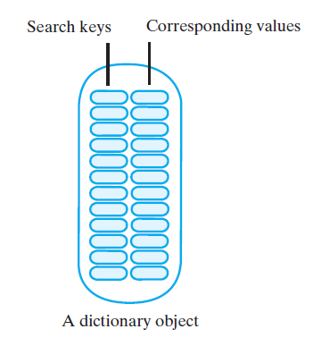
ADT Dictionary
A set of entries
each entry contains Keyword (search key) and Value

Slide 4
Hash Table (HT)
Search through a collection in O(1) with relatively small extra space
Basic Premise:
an array of length m (call it HT)
a hash function h(x)
maps from keys to the set {0, 1, 2, …, m-1}

Slide 5
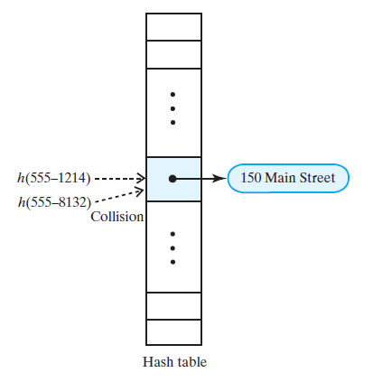
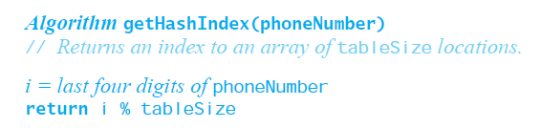
Collisions
Collision: hash function maps a key into a location already in use
tableSize = 101
555-1264

Slide 6
Good Hash Functions
A good hash function:
minimizes collisions
fast to compute
To reduce the chance of a collision
Utilize the entire key
Exploit differences between keys
Distribute entries uniformly

Slide 7
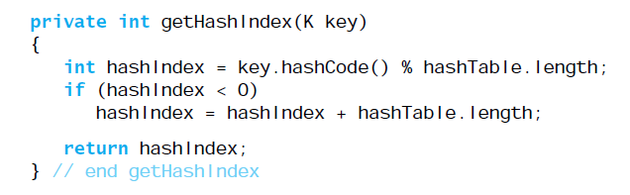
Computing Hash Values
Object has a method hashCode
returns an integer hash code
Classes should override hashCode
A hash code for a String
multiply ASCII/Unicode char value by place-value, then sum
called Horner’s method

Slide 8
Horner's method
Base 10
12345
= 1 * 10⁴ + 2 * 10³ + 3 * 10² + 4 * 10¹ + 5 * 10⁰
Base 2
10100
= 1 * 2⁴ + 0 * 2³ + 1 * 2² + 0 * 2¹ + 0 * 2⁰
Base 16
BEEF3
= 11 * 16⁴ + 14 * 16³ + 14 * 16² + 15 * 16¹ + 3 * 16⁰
ASCII Strings
HELLO
= 'H' * 256⁴ + 'E' * 256³ + 'L' * 256² + 'L' * 256¹ + 'O' * 256⁰
= 72 * 256⁴ + 69 * 256³ + 76 * 256² + 76 * 256¹ + 79 * 256⁰

Slide 9
Resolving Collisions
Collisions cannot be avoided if
|keyspace| > m and
keys not known a priori
Two choices to resolve collisions:
Use another location in the hash table (open addressing)
Change the structure of hash table
each location can represent multiple values (closed addressing)

Slide 10
Open Addressing
Table locations checked in a probe sequence
Probe sequence has to be consistent and predictable
so that entries can be located later
Linear probing
Resolves a collision by examining consecutive locations
Beginning at original hash index
Find the next available one
Until an open space is found
If probe sequence reaches end of table, go to beginning of table (circular)

Slide 11
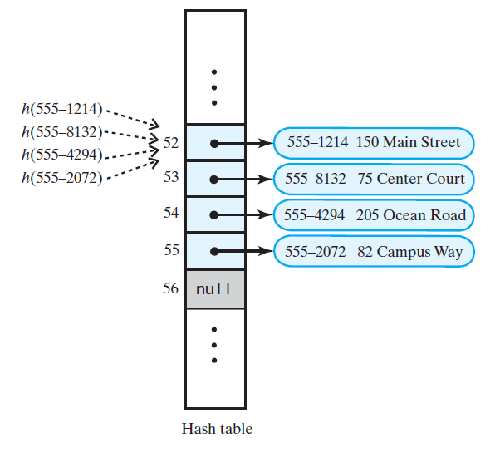
Search with Linear Probing
If another key is stored at index i = hash(key)
Check i+1, i+2, i+3 … until
Key is found
Empty (null) location is found
We circle through the buffer back to i
555-1264

Slide 12
Linear probing example
h(x) = x mod 11
Insert 14, 17, 25, 37, 34, 16, 26
0
1
2
3
4
5
6
7
8
9
10
34
14
25
37
17
16
26
Notes:
Discuss implementing as a symbol table
Delete 17, look for 26
How to resolve?
Could flag deleted, and eventually redo whole table
Or redo rest of the cluster on every delete

Slide 13
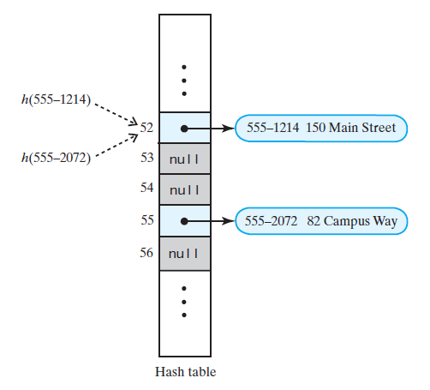
remove with Linear Probing
What if remove uses null to remove entries
Remove 555-8132 and 555-2904
(555-1264)
(555-1264)
What problem do you see?

Slide 14
Linear probing example
h(x) = x mod 11
Insert 14, 17, 25, 37, 34, 16, 26
0
1
2
3
4
5
6
7
8
9
10
34
14
25
37
17
16
26
How would deletes be handled?
What happens if key 17 is removed?
Then we search for 26 after deleting 17
Notes:
Discuss implementing as a symbol table
Delete 17, look for 26
How to resolve?
Could flag deleted, and eventually redo whole table
Or redo rest of the cluster on every delete

Slide 15
Handling Deletions in Linear Probing
Three kinds of locations in the hash table
Occupied—location references an entry in the dictionary
Empty—location contains null
Available—location’s entry was removed

Slide 16
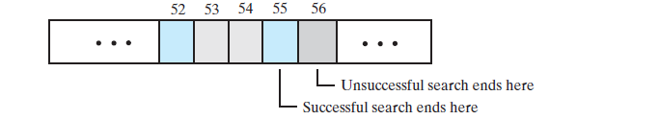
Clustering
Cluster: a group of occupied consecutive locations
Bigger clusters mean longer search times
Example: A cluster of size 4 starting at index 52
Linear Probing causes clusters

Slide 17
Clusters tend to grow bigger
Consider an empty table using a good hash function
probability a key inserted into any one of table indices?
1/m (m is table size)
Consider a table that has a cluster of size c
probability a key inserted into index directly after cluster?
c/m
Clusters have a high probability to grow

Slide 18
Double Hashing
even after a collision, all indices are equally likely
Double hashing uses a second hash function
first probe: first hash index
next probe: previous probe + second hash index
key-dependent probe sequence

Slide 19
Double hashing Example
h(x) = x mod 11
h₂(x) = (x mod 7) +1
Insert 14, 17, 25, 37, 34, 16, 26
0
1
2
3
4
5
6
7
8
9
10
34
14
37
16
17
25
26
Why could we not use h₂(x) = x mod 7?
insert 2401
2401 mod 11 == 3
2401 mod 7 == 0
Notes:
Why should h2(x) not be 0? try inserting 2401
2401 mod 11 == 3
2401 mod 7 == 0
Try inserting 15 at end

Slide 20
A few extra rules for h₂()
Second hash function cannot map to 0
Should try all indices once before trying one twice

Slide 21
Open Addressing Problem
Each location is either occupied, empty, or available
Frequent adds and removes result in no empty spots
i.e., one big cluster
Search time → O(m)
Consider separate chaining as a solution

Slide 22
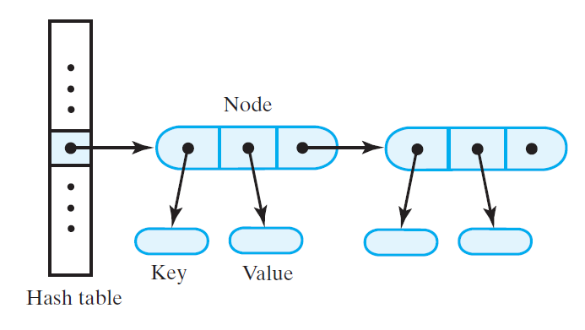
Separate Chaining
Alter the structure of the hash table
Each location can represent more than one value
Such a location is called a bucket
how to represent a bucket?
list, sorted list
array, vector, or linked nodes

Slide 23
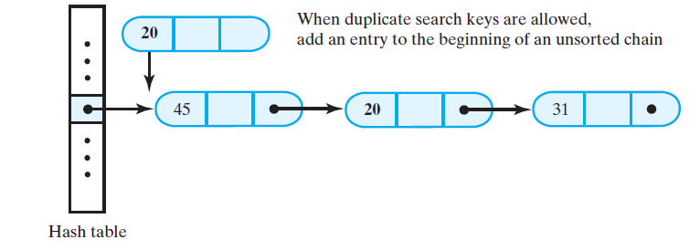
Inserting with Separate Chaining
Idea 1: Insert at beginning of unsorted chain
Problems?

Slide 24
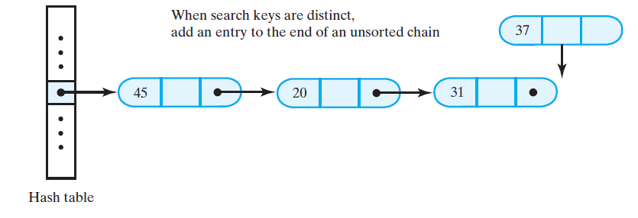
Inserting with Separate Chaining
Idea 2: Insert at end of unsorted chain

Slide 25
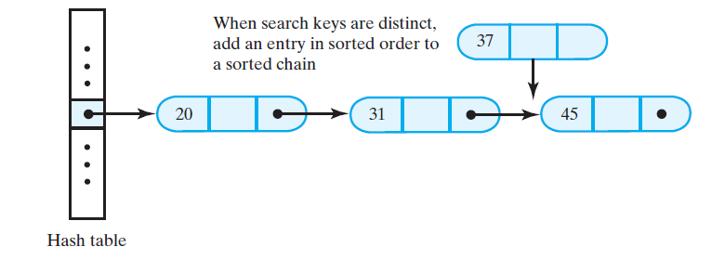
Inserting with Separate Chaining
Idea 3: Insert in sorted order to sorted chain

Slide 26
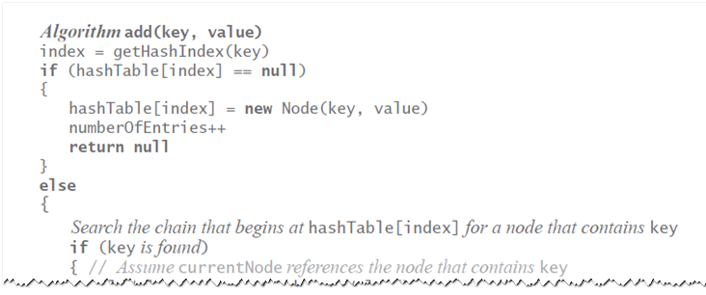
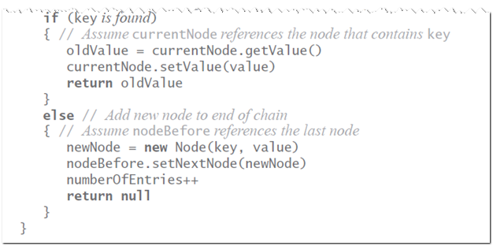
add with Separate Chaining

Slide 27
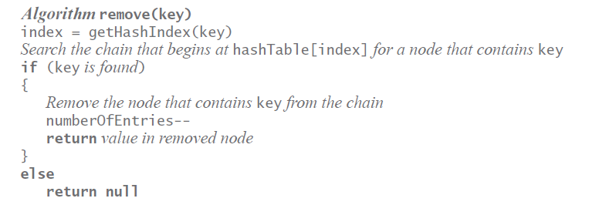
remove with Separate Chaining

Slide 28
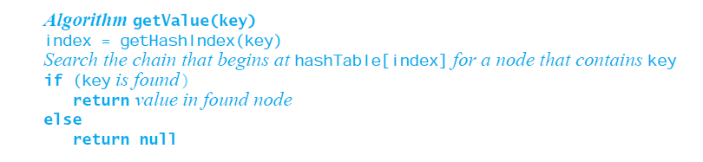
getValue with Separate Chaining

Slide 29
Efficiency of Hashing
Successful remove same efficiency as successful search
Unsuccessful remove same efficiency as unsuccessful search
Successful add same efficiency as unsuccessful search
Unsuccessful add same efficiency as successful search

Slide 30
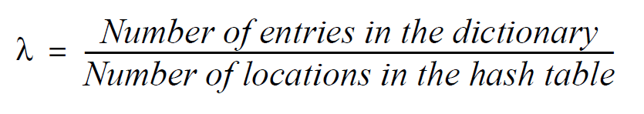
Load Factor
Never negative
For open addressing, 1 ≥ λ
For separate chaining, λ has no maximum value
Restricting λ improves performance

Slide 31
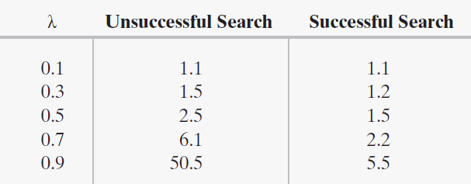
Linear Probing
average number of comparisons vs. load factor

Slide 32
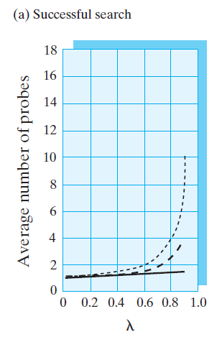
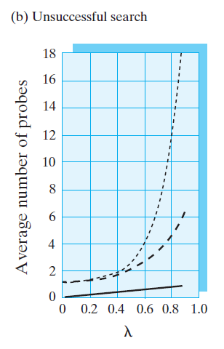

Performance Comparison

Slide 33
Maintaining Performance of Hashing
To maintain efficiency, restrict λ as follows:
λ < 0.5 for open addressing
λ < 1.0 for separate chaining
Should the load factor exceed these bounds
Resize the hash table

Slide 34
Rehashing
When load factor λ is too large, resize the hash table
table’s new size?
Double its present size
Increase the result to the next prime number
Use add to add current entries to new hash table

